Slide 1
LEDS
The Ultimate No-Brainer

Slide 2
What are LEDs
The electrical energy in incandescent bulbs must be converted into heat before light can be produced.
Light Emitting Diodes (LEDs) are able to transform electrical energy directly into light energy.
They convert 95% of electricity used into light and only 5% into heat
LEDs use up to 90% less energy than incandescent bulbs and up to 60% less than fluorescent lighting
They contain no harmful chemicals such as those used in fluorescent lights

Slide 3
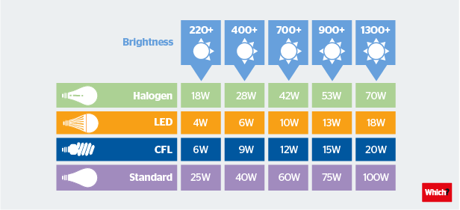
Comparison of light bulbs and outputs

Slide 4
Cost, Energy and Maintenance Savings
Installing LEDs will definitely reduce your electricity usage
LEDs last much longer than other bulbs
100 watt incandescent bulbs last approx. 1000 operational hours
Fluorescent lamps last approx. 15,000 operational hours
LEDs last approximately 50,000 – 75,000 operational hours
LEDS need replacing far less frequently
Less frequent replacement means less maintenance and a reduction in manufacturing, transportation and use of raw materials →
reduced carbon footprint

Slide 5
Fewer replacements are also good for health and safety, especially in churches with high ceilings or where scaffolding may be needed

Slide 6
Some Drawbacks
LEDs are more expensive than ordinary bulbs
Not all fittings, especially heritage fittings in listed buildings are suitable
Changing fittings may involve the use of scaffolding or rewiring
Some churches may be unable to afford the cost – but possible to run funding schemes e.g. at St Peter’s we asked members of the congregation to donate the cost of one bulb

Slide 7
How to set about it
Plan well – contact the Church of England Birmingham’s lighting adviser Tim Bowden – through Ben Smith, the DAC Secretary
Read the CCB lighting guidance on the Church of England website https://www.churchofengland.org/sites/default/files/2022-05/CCB_Lighting_guidance.pdf
Consider the age of your fittings – it might be more cost effective in the long run to replace fittings near the end of their life

Slide 8
Some further information
Outside lights and floodlights can also be replaced by LEDS
Existing fluorescent lighting can usually be easily replaced
If you are making changes, consider installing sensors in toilets, kitchens and hallways to make further savings
Buy good quality bulbs for the longest life – particularly in difficult to reach spaces
Research bulb suppliers and buy all bulbs the same
Buy a good brand – Phillips, Osram
Remember - though the initial cost may be high, your investment will soon be repaid

Slide 9
Useful websites
https://www.churchofengland.org/sites/default/files/2022-05/CCB_Lighting_guidance.pdf
https://energysavingtrust.org.uk/advice/lighting
Ben Smith Diocesan Property team - dac@cofebirmingham.com
www.lyco.co.uk Bulk lighting supplier

Slide 10
Thank you
Any Questions?

