Slide 1
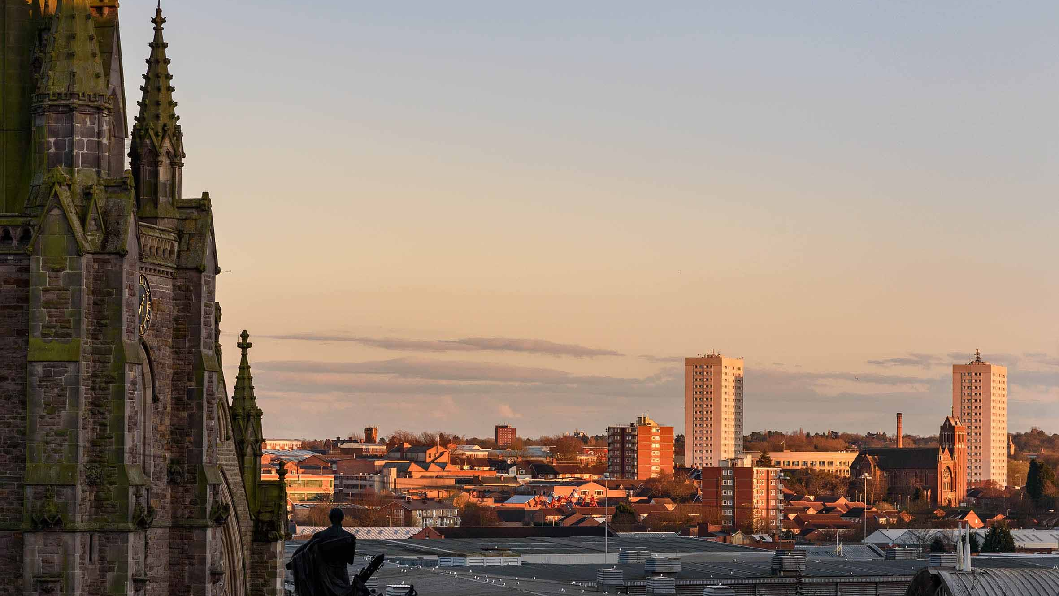
CofE Birmingham & Net Zero Carbon
Ben Smith
Care of Churches Officer

Slide 2
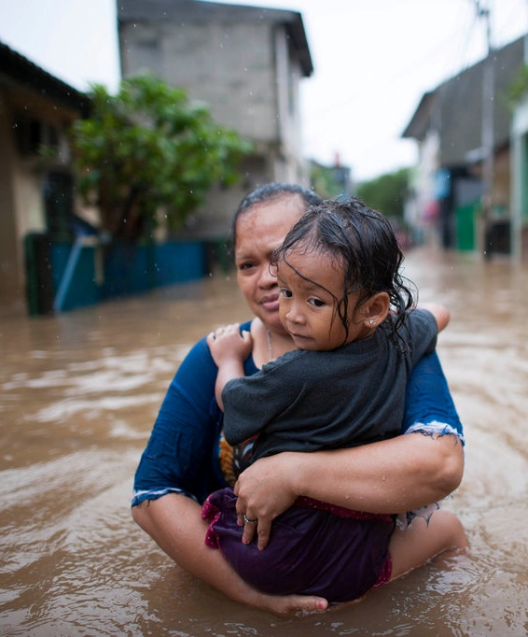
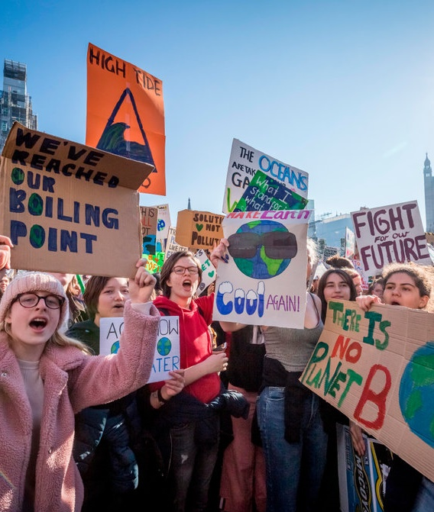
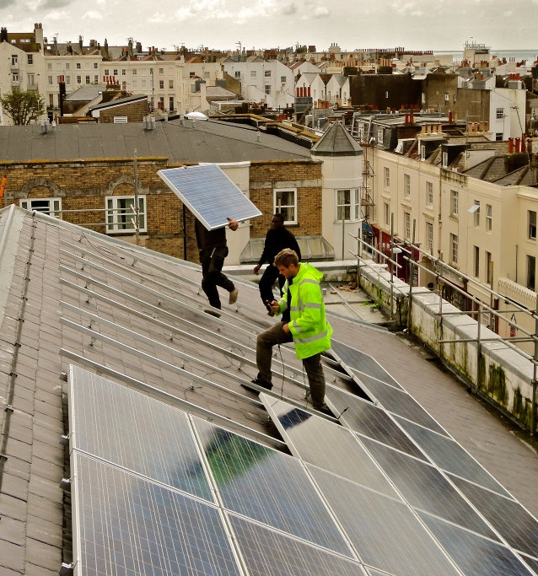
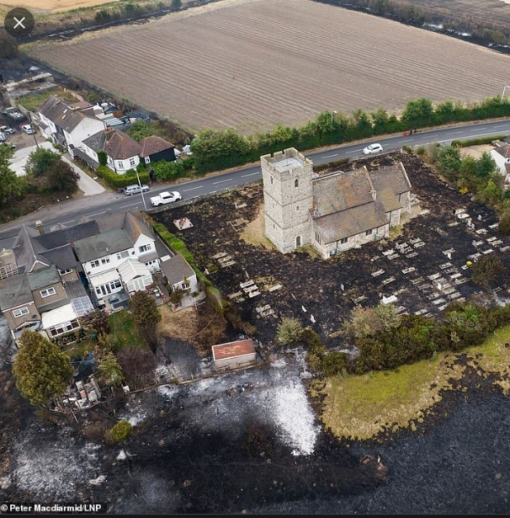
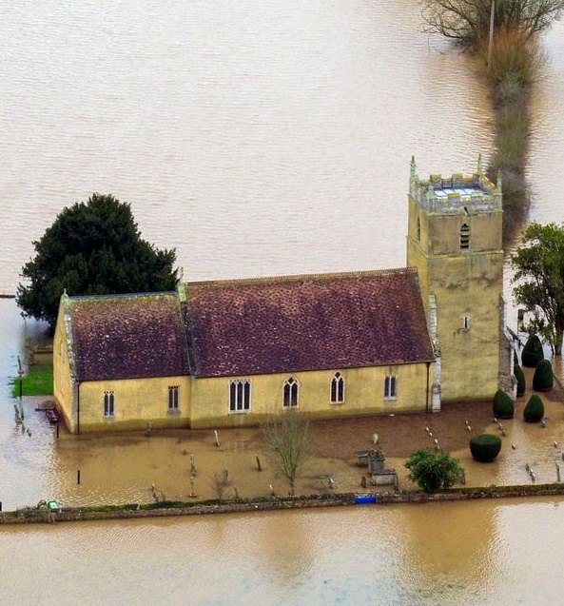
Why focus on net zero carbon, when there are so many other pressures?
Notes:
In Feb 2020 the CofE General Synod agreed a motion for all parts of the Church to work to achieve year-on-year reductions in emissions with the aim of becoming net zero carbon by 2030
General Synod recognised that “the global climate emergency is a crisis for God’s creation, and a fundamental injustice” and you might be thinking “yes, but there are many other pressures demanding our attention”
dealing with financial pressures, dealing with staff shortages, dealing with safeguarding. Why focus on net zero carbon?
There are four reasons to prioritise this work:
(1) Climate justice. Climate change impacts the poorest countries, and the poorest people, the most. Climate change is caused by greenhouse gas emissions. We are part of the problem, however small, so we need to be part of the solution.
(2) Intergeneration justice, and being relevant with young people. What are we saying to them, if we aren’t taking action ourselves?
(3) Credibility. Many people within the Church are calling for government and big corporations to do more, faster. They are pushing for divestment. If we want to be credible in those discussions, we need to be taking action ourselves. And we want to be credible when we ask people in our communities to do more.
(4) Because of the impact climate change will have on our buildings and our communities if we don’t.
The flip side is taking a positive view of what our Church and our world could look like when we get there; more justice, more young people engaged, cheap renewable electricity from our roofs, greater protection from storms.

Slide 3
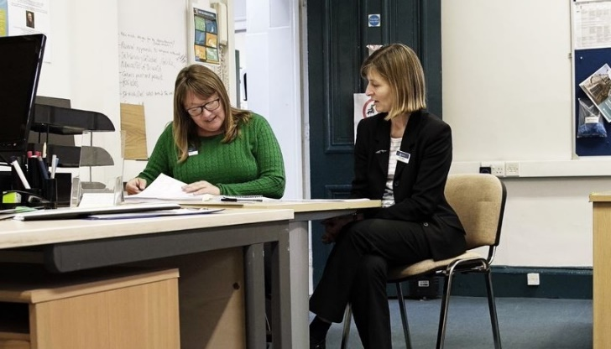
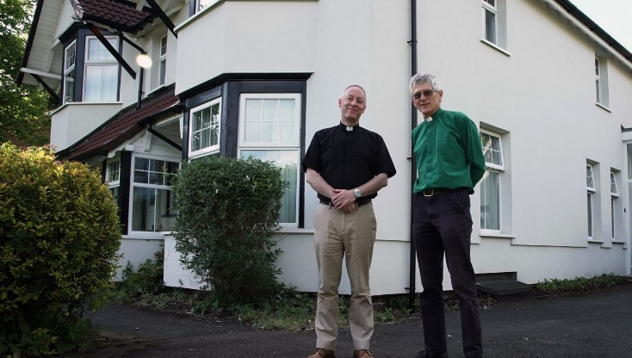
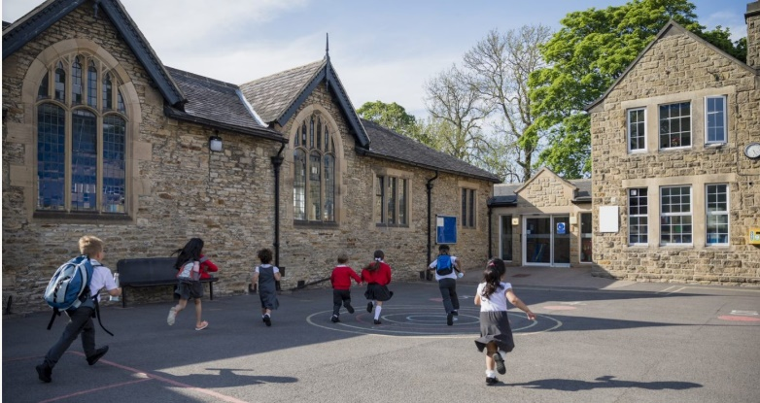
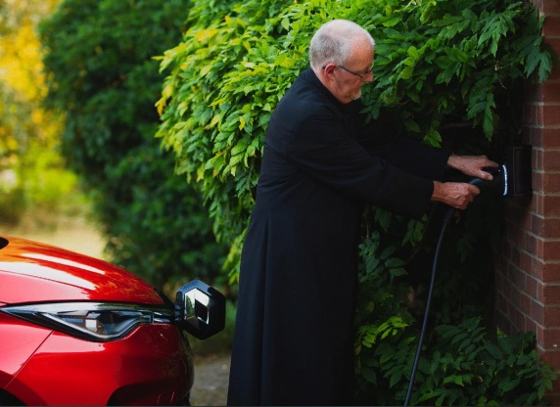
What is in scope for our diocese?
182 Churches
45 Schools
Cathedral
150 Clergy Houses
Diocesan Office
Work-related Travel

Slide 4
CofE Birmingham sources of emissions
Total 7,500 CO2e tonnes per year
2021 data

Slide 5
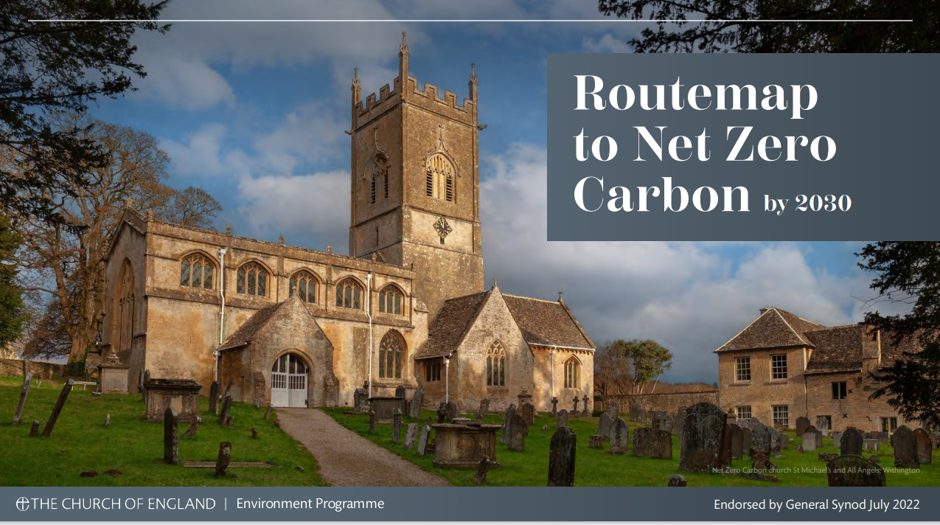
CofE Routemap to Net Zero Carbon
Notes:
Focus of the next few of years is on gathering data on current energy use, planning for net zero carbon, communicating the importance of the issue, and focusing on simple ways of reducing energy as a starting point.

Slide 6
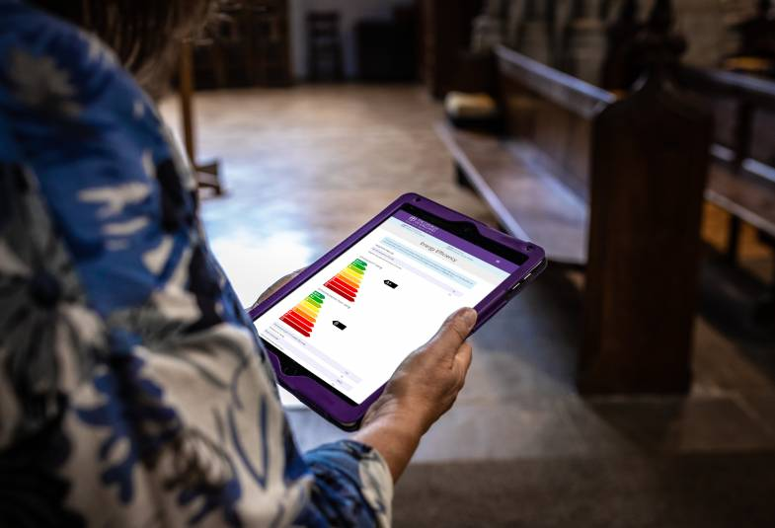
Energy Footprint Tool
What is it?
Allows churches to find out your current ‘carbon footprint’
Churches enter previous year’s utility bill information
62% of CofE Birmingham churches submitted EFT returns in 2022
Notes:
Key way of gathering data on church energy use
Carbon footprint of churches and halls
Based on energy used to heat and light church buildings and church halls

Slide 7
Energy Footprint Tool
Why use it?
Allows you to understand where you are starting from
Submitting annual returns allow you to see year-on-year progress
Allows diocese and national teams to understand the bigger picture and where extra support is needed

Slide 8
Energy Footprint Tool
How to use it?
Access through the CofE Online Parish Returns System
You will need your 2022 electricity and gas/oil bills to hand
Open until end of July 2023

Slide 9
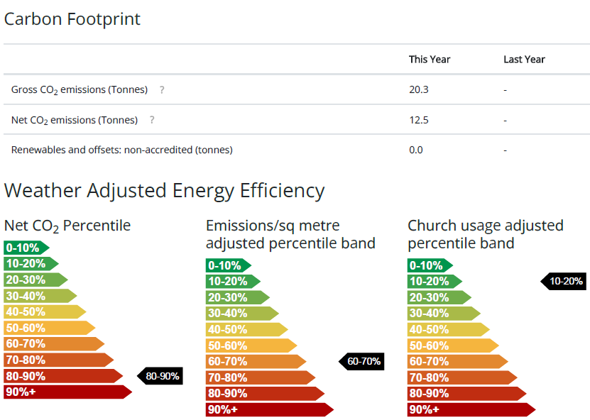
Energy Footprint Tool

Slide 10
What Next?
Start to plan actions to reduce carbon emissions for your church buildings
‘Practical Path to Net Zero Carbon’ document
‘Practical suggestions to help parishes save energy and money’ document
CofE ‘Net Zero Carbon’ webinar programme

Slide 11
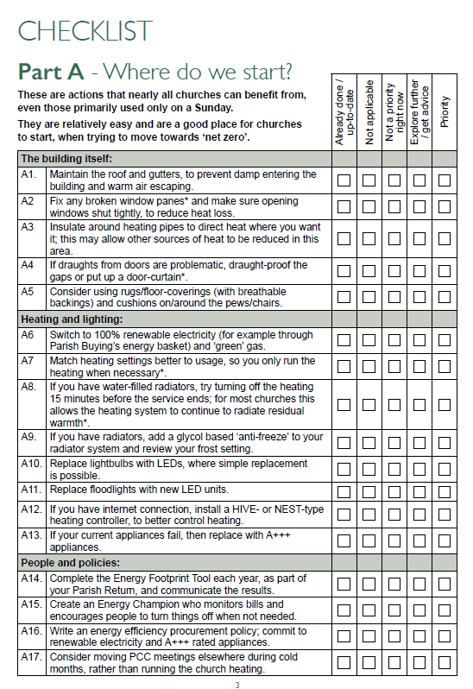
Practical Path to Net Zero Carbon
A tool to identify possible actions to reduce church carbon emissions
Starts with relatively simple ‘quick wins’ that nearly all churches can benefit from
Up to bigger, more complex projects
Notes:
No one size fits all method
Many churches already have a low carbon footprint, may only really need to focus on good building maintenance and a few small operational changes

Slide 12
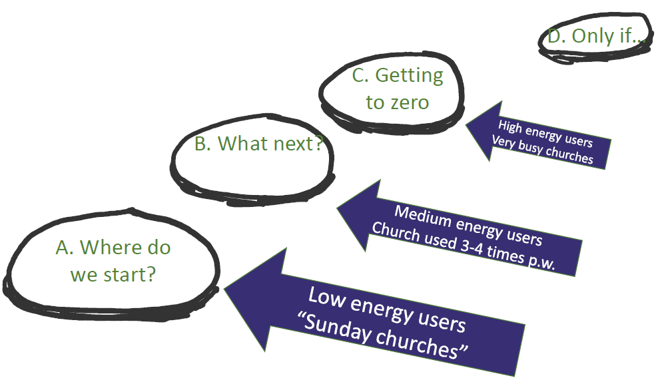
Practical Path to Net Zero Carbon

Slide 13
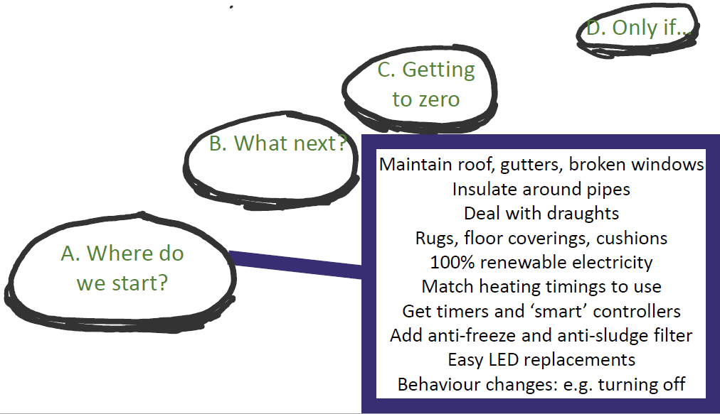
Practical Path to Net Zero Carbon
Notes:
Low energy users – Sunday churches

Slide 14
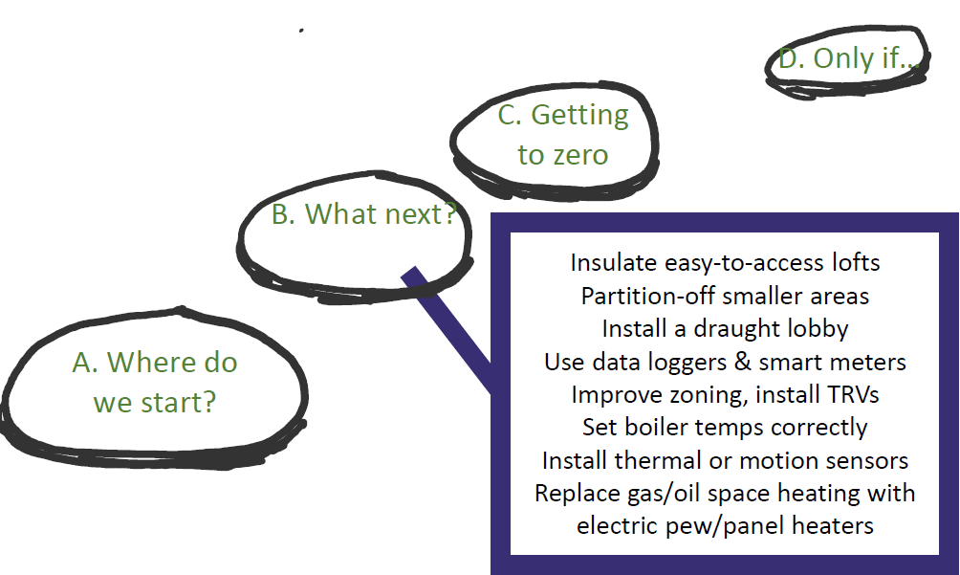
Practical Path to Net Zero Carbon
Notes:
Medium energy users – used 3-4 times per week

Slide 15
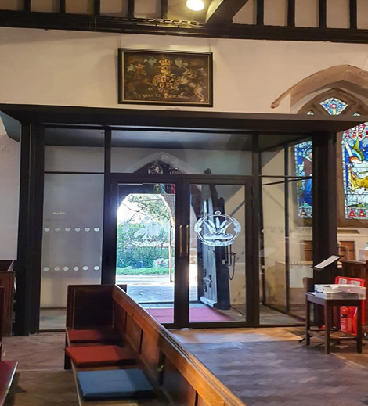
Practical Path to Net Zero Carbon
Notes:
Medium energy users – used 3-4 times per week

Slide 16
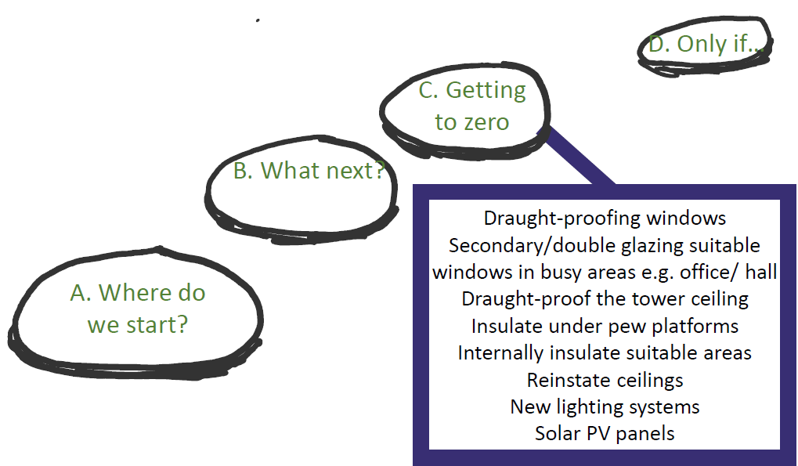
Practical Path to Net Zero Carbon
Notes:
High energy users – v busy churches

Slide 17
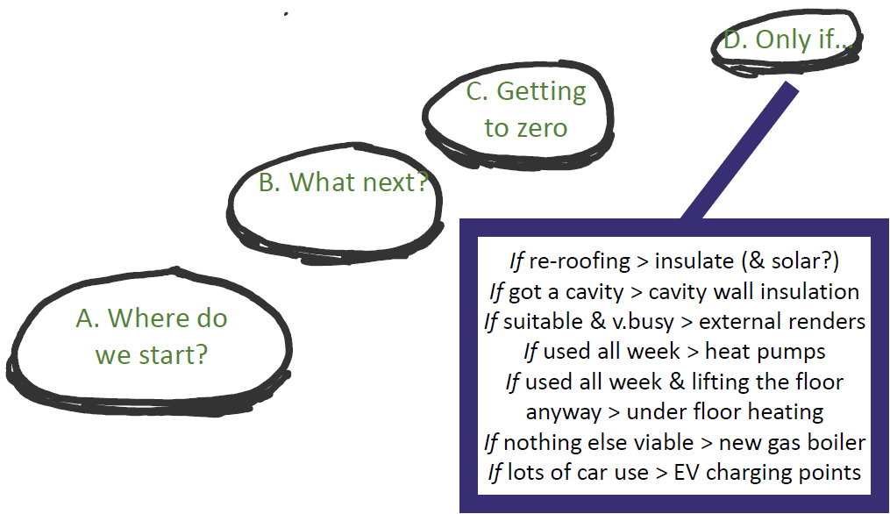
Practical Path to Net Zero Carbon
Notes:
Only in certain circumstances

Slide 18
Practical Path to Net Zero Carbon
Further Links
Online Parish Returns Tool to complete Energy Footprint Tool
- https://parishreturns.churchofengland.org/login
CofE Net Zero Carbon church webpage
- https://www.churchofengland.org/resources/churchcare/net-zero-carbon-church
Practical suggestions to help parishes save energy and money
- https://www.churchofengland.org/sites/default/files/2022-11/PO0518%20COFE%20PRACTICAL%20SUGGESTIONS%20DOCUMENT%20%28INTERACTIVE%29%20V2%202.pdf
Green Energy Companies and the Energy Footprint Tool
- https://www.churchofengland.org/sites/default/files/2023-01/Green%20Energy%20Companies%20and%20the%20Energy%20Footprint%20Tool%20Jan%202023.pdf
A practical path to “net zero carbon” for our churches
- https://www.churchofengland.org/sites/default/files/2021-01/the-practical-path-to-net-zero-carbon-numbered-Jan2020.pdf
A practical path to net zero carbon (A checklist for your church)
- https://www.churchofengland.org/sites/default/files/2021-01/PP2NZC_SelfGuidedChecklist_print_version.pdf
Notes:
Only in certain circumstances

Slide 19
Thank you bens@cofebirmingham.com 07741 146105

