Slide 1
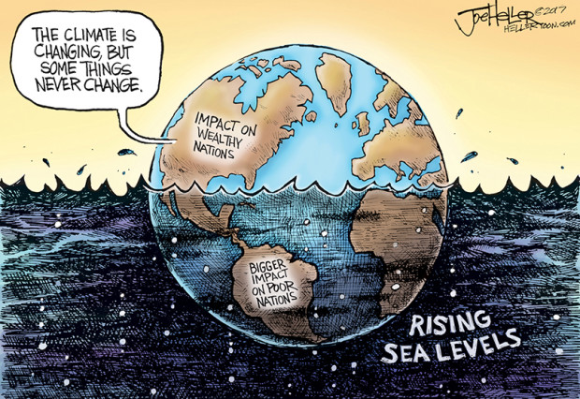
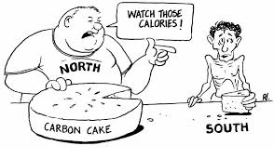
Climate Justice

Slide 2
The Five Anglican Marks of Mission
To proclaim the Good News of the Kingdom
To teach, baptise and nurture new believers
To respond to human need by loving service
To seek to transform unjust structures of society, to challenge violence of every kind and to pursue peace and reconciliation
To strive to safeguard the integrity of creation and sustain and renew the life of the earth
Notes:
Whilst the fifth mark of mission is the one we would most obviously associate with the climate crisis, creation care is threaded through all of them and the fifth mark can be seen as the missionary priority on which all other marks depend. All the marks of mission demand ecological engagement.
The fifth mark of mission is about our responsibility, as followers of Christ, to protect creation.
If we are to proclaim the good news of the Kingdom, we need to earn a hearing and be authentic and credible. Sensitive evangelism addresses context and we are living in the context of an ecological and climate crisis. Mark 16:15 asks us to ‘proclaim good needs to all creation.’ What would good news for the entire cosmos look like?
The second mark asks us to teach, baptise and nurture so that we may be formed into the likeness of Christ. Context here is crucial. Are we equipping Christians to respond to the challenges the climate crisis presents?
The third mark is concerned with people not the planet, but the climate crisis is creating human need. From those who are no longer able to produce a harvest and those who have lost their homes to flooding to those who are mourning the loss of species and countryside.
The fourth mark is about justice and the climate crisis is a justice issue. Globally the poorest have caused the least harm but are already suffering the worst consequences. Older generations are bequeathing a crisis to the next generation.
BACKGROUND: The Environment and The Five Marks of Mission document by Ruth Newton and John Hughes
2

Slide 3
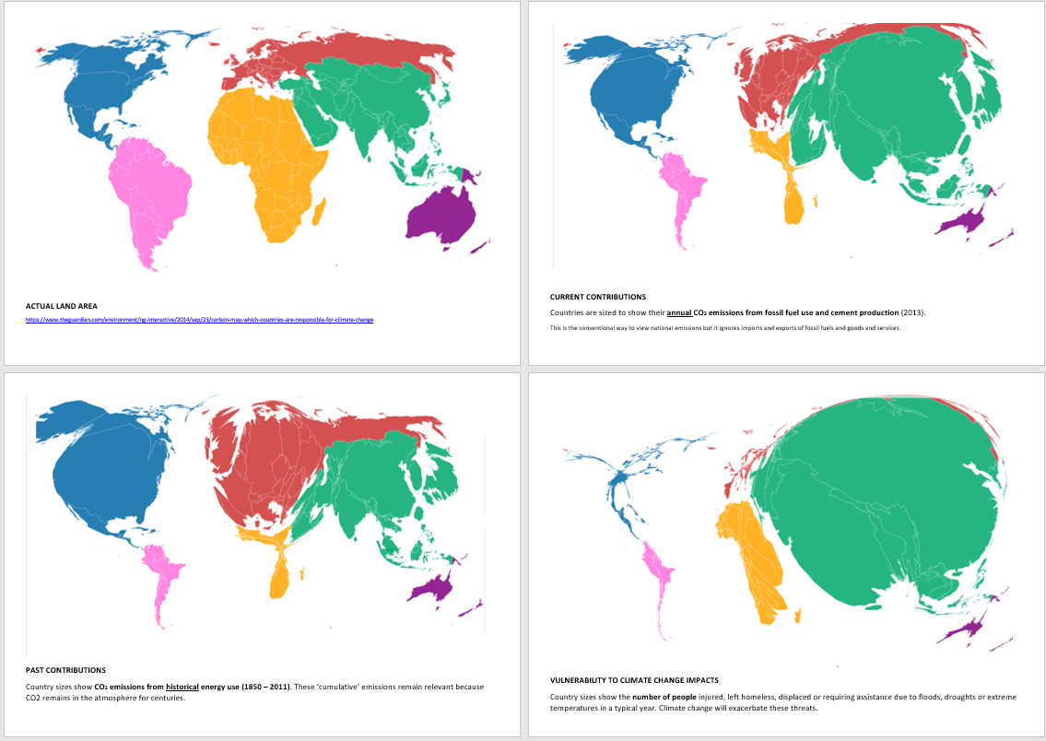
Notes:
DRAW OUT in plenary discussion:
Most emissions by western countries – UK has emitted a huge amount
Most impacts on developing countries – even though they have not caused it.
Developing countries have to be allowed to develop, even if not to the extent that we have – they will have to have a larger portion of the remaining carbon budget – we have already spent a lot of ours.
3

Slide 4
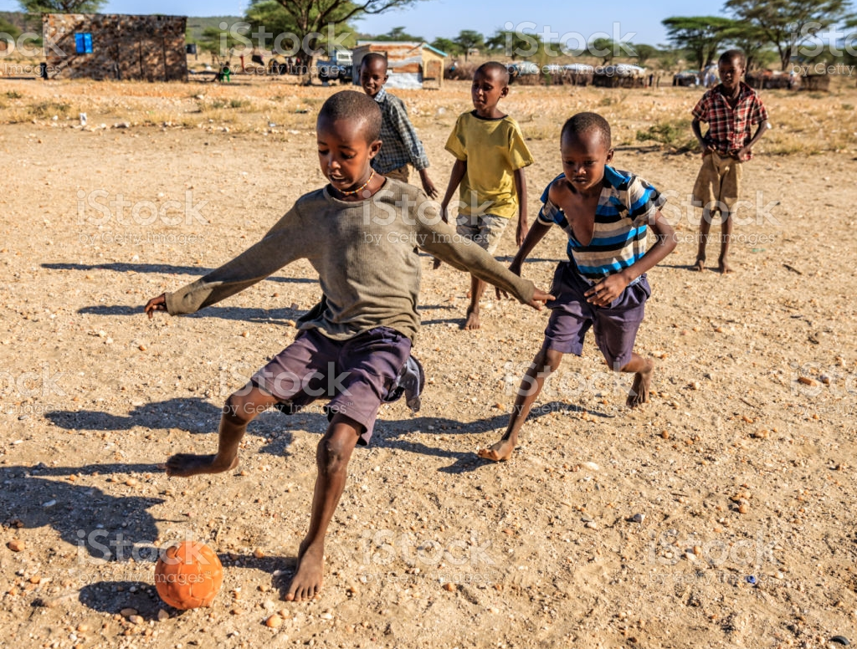
Our carbon footprints
Developed world
Child to 18 years – over 1,000 tonnes CO₂
Mali
Child to 18 years – less than 2 tonnes CO₂

Slide 5
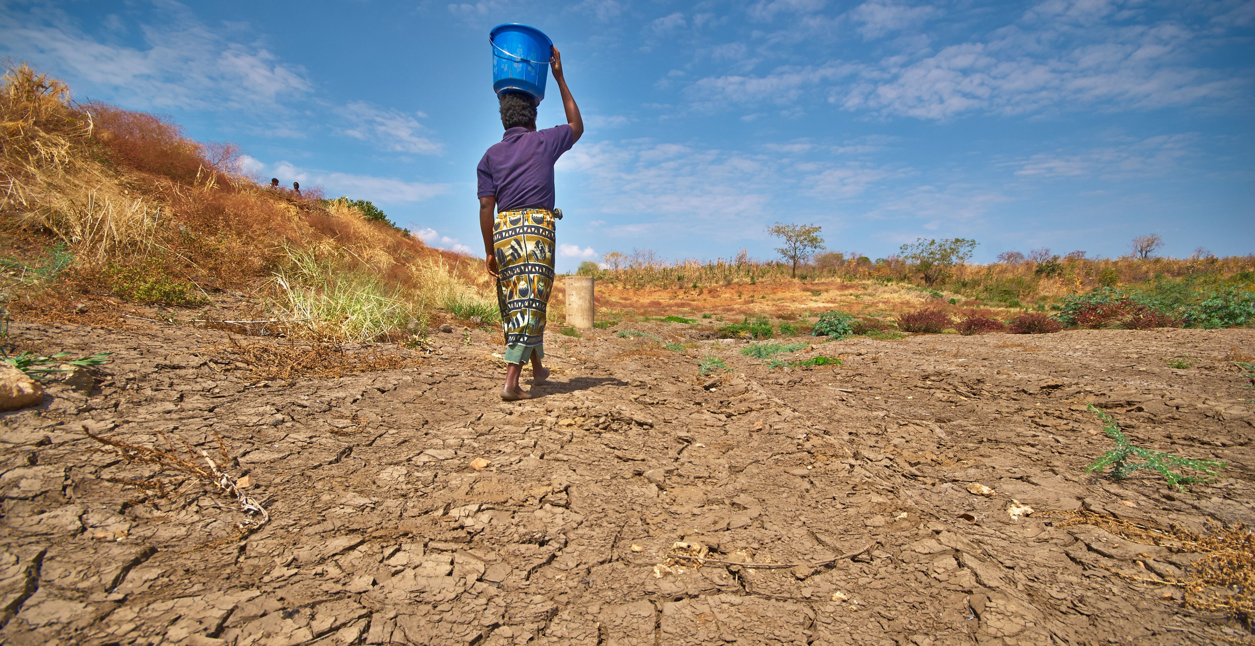
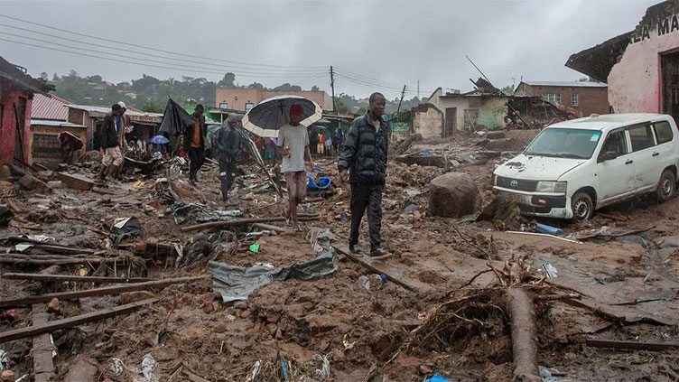
Climate Justice - Malawi
One of the lowest carbon emitting countries – average carbon footprint 0.2 tonnes
9 in 10 depend on rain fed agriculture
2021 – 5th worst affected by climate-related droughts and floods
Led to widespread cholera outbreaks
Now in March 2023 - Cyclone Freddy
Notes:
TEMPLATE SLIDE - you can adapt this slide to suit your local circumstances. If you don’t have a story, you can simply delete this slide.
5

Slide 6
What can we do?
Give – supporting Christian Aid, Tearfund etc
Talk – to family, friends, neighbours, colleagues….
Call – for government action in
- maintaining/increasing aid
- contributing our fair share of the annual $100 billion promised to poor countries at COP26 to combat/adapt to climate change
- contributing our fair share of the loss and damage fund agreed at COP27, compensating worst climate change-affected countries

Slide 7
